Slide 1
EMS Fee Ordinance Update
Presented by:
Deputy Chief Adam Mitchell and Assistant Chief Jon Rudnicki
May 14, 2026

Slide 2
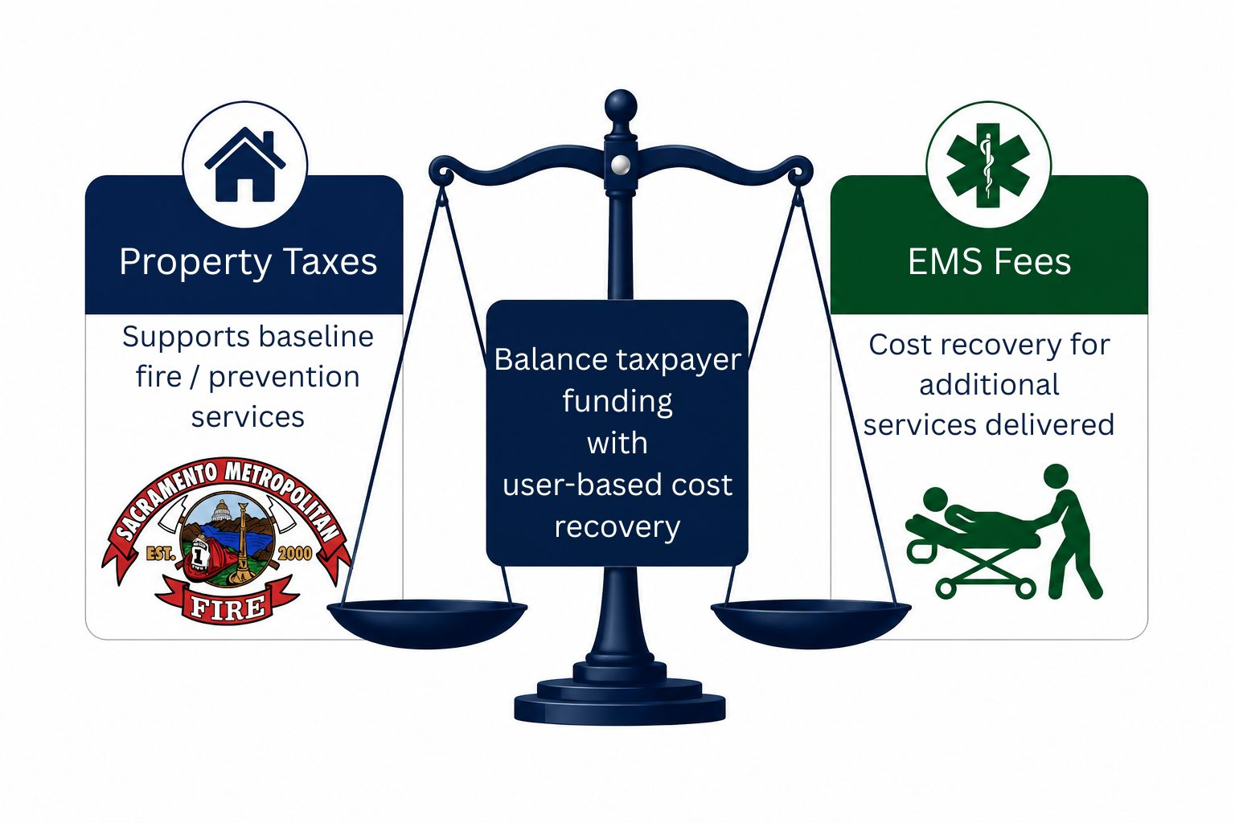
Why EMS Fees Exist
Notes:
Special district with Multiple funding sources
Primary funding: property taxes (supports baseline fire/prevention services)
EMS fees provide cost recovery for additional services delivered
Goal: balance taxpayer funding with user-based cost recovery

Slide 3
EMS Cost Recovery Overview
EMS costs continue to increase (staffing, equipment, readiness)
Fee recovery currently ~30% of actual costs
Federal reimbursement limits (Medicare/Medicaid)
Fees align with industry standards and peer agencies
Notes:
- Legislative action
- PPGEMT / CARE ACT /
FY 26/27 PROJECTION
Treatment on Scene fee recovery (first responder & TNT(assessment))
Charges = $9.1M
Recover = $2.6M (28.61% of charges)
Private Pay = $896K (34% of recovered)

Slide 4
History of EMS Fee Ordinance
Last comprehensive study completed in 2017
Updates made in 2023 based on comparable agencies
2025 EMS Fee Study provides full operational and financial review

Slide 5
EMS Fee Study Process
Board direction and strategic intent
Service delivery and operational modeling
Financial modeling based on cost of service
Policy and ordinance development
Implementation planning
Notes:
Delete

Slide 6
EMS Fee Ordinance
Board Engagement and Feedback
Initial study presented September 2025
Board provided direction on key areas
Follow-up discussions and clarification (December 2025 presentation)
Consensus direction incorporated into ordinance and fee schedule

Slide 7
Workforce Feedback
Letters and input from field personnel
Concerns included fairness, transparency, and patient impact
Staff reviewed and incorporated feedback where feasible
Communication plan developed to support workforce understanding

Slide 8
Key Ordinance Updates (High-Level)
Clear billing triggers tied to documented patient care
Defined service categories (Transport, Treatment on Scene, MIH, Add-ons)
Clarified automatic aid billing structure
Expanded patient protections (low-income and hardship programs)
Added reference to billing policies and procedures

Slide 9
Fee Schedule – Key Changes
Staff recommendation based on EMS Fee Study
Elimination of night charge (Board direction)
Addition of MIH service fees
Separate line items for transport with/without first responder
Improves transparency and alignment with service delivery

Slide 10
Ongoing Fee Adjustments
Annual CPI-based adjustments each July 1 (been in place for years)
Maintains alignment with rising EMS costs
Ensures long-term sustainability
Notes:
+

Slide 11
Policy & Procedure Flexibility
Ordinance references EMS billing policies and procedures
Includes low-income assistance and billing dispute processes
Allows updates without reopening ordinance
Improves responsiveness to issues post-implementation

Slide 12
Internal & External Communication Plan
Internal: workforce education, FAQs, quick reference tools
External: transparency with public and stakeholders
Goal: consistent messaging and reduced confusion
Reinforces that billing does not influence clinical care

Slide 13
Implementation Steps
Finalize ordinance and fee schedule
Adopt resolutions
Update policies and procedures
Coordinate with third-party billing provider
Rollout communication plan

Slide 14
Summary
Targeted updates based on the study, Board input, and workforce feedback
Improves clarity, consistency, and transparency
Maintains sustainable EMS cost recovery
Supports both workforce and community

Slide 15
Staff Recommendation
5/14/26
    Adopt EMS Fee Study
5/28/26
    Adopt the resolution updating the EMS Fee Ordinance
    Adopt the proposed fee schedule
    Adopt the resolution rescinding the previous ordinance

Slide 16
EMS Fee Ordinance
Questions and Comments
Notes:
With that, we welcome your questions and how we can support your deliberations.

